Slide 1

Banking analytics
Meet the team
Ms. Shivani Dogne
Ms. Laiba Sajid Shaikh
Ms. Vrushali Rajaram Wavdhane
Mr. Shubham Anil Dhage
Mr. Kunal Kishor Shinde
Mr. Ajo K Abraham
Mr. Ajith Kumar
Under the guidance of Mr.Shubham Kabre

Slide 2

About:
Banking Analytics is one of the world's leading financial institutions, serving individuals, small- and middle-market businesses, large corporations, and governments with a full range of banking, investment management, and other financial and risk management products and services.
Department: Finance
Target Data: 2007-2011
Customers: 36,000
Purpose: Funding
Objective:
The primary goal of this project is to analyze the seasonality of Financial data from 2007-2011 and create adequate plans to know the total loan amount recovered and year-wise loan amount.

Slide 3
Data Information
We have two datasets that are Finance 1 & Finance 2.
In Finance 1, there are 39,718 Rows and 24 Columns.
In Finance 2, there are 39,718 Rows and 25 Columns.

Slide 4
Data Processing:
1. Data Understanding: The key to success on any data project is a thorough understanding of the data. As a result, we took the time to learn about your company's data model and domain.
2. Data Cleaning: After learning about your company, we cleaned up the accessible datasets and considered what an ideal dataset for this topic would look like.
3. Data Modelling: After confirming that the data was clean for analysis, we needed to process and model it into a dataset capable of precisely answering the business questions and producing the required outcomes.
4. Data Analysis : We used our analytical capabilities to identify insights from our new dataset and to create visualizations to describe the insights
5. Uncover Insights:. Finally, we applied these insights to create business decisions and recommendations for next steps.

Slide 5
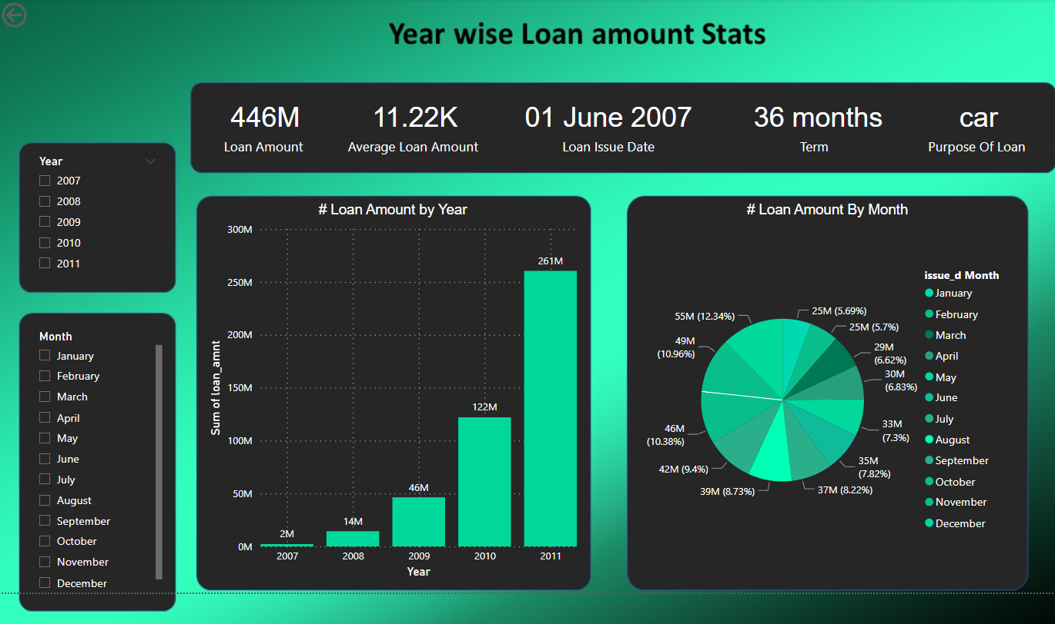
KPI-1 year wise loan amount stats.
The total loan amount was increased by every year.
The state CA has occupied the majority of the loan amount 80M.
The state OK is occupied the least loan amount of 3M.

Slide 6
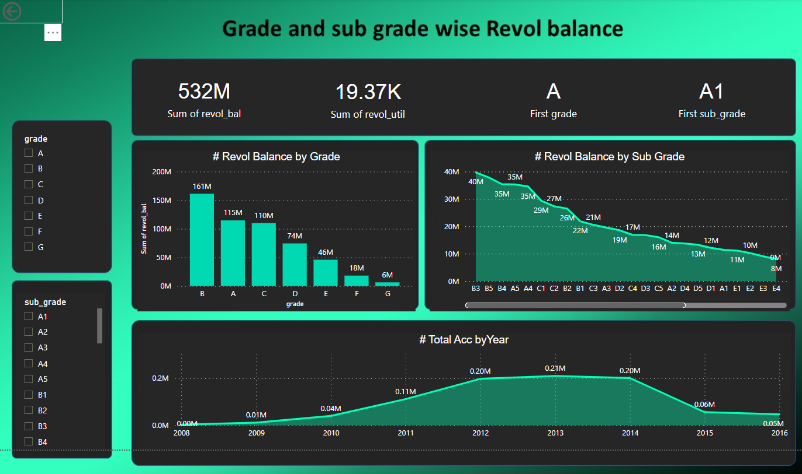
KPI-2 grade and sub grade wise revol balance.
Grade B has more Revolving balance and Grade G has least Revolving balance.
Also annual income is high in B3 subcategory and less in G5 subcategory.

Slide 7
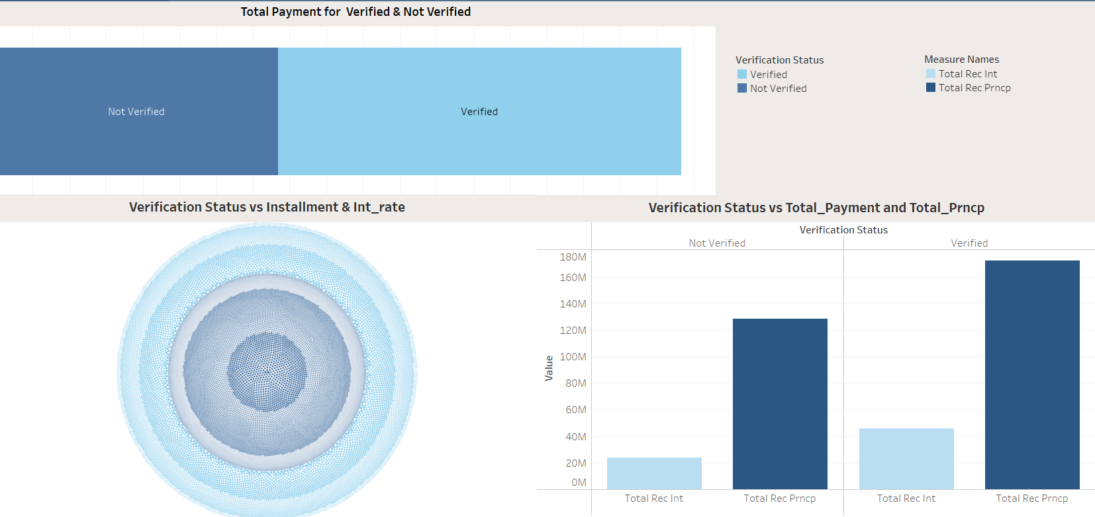
KPI-3 total payment for verified status vs non-verified status.
Verified status contains major last payment amount as compared to non Verified status.
Total Rec Principal is more than Total Rec interest Principal

Slide 8
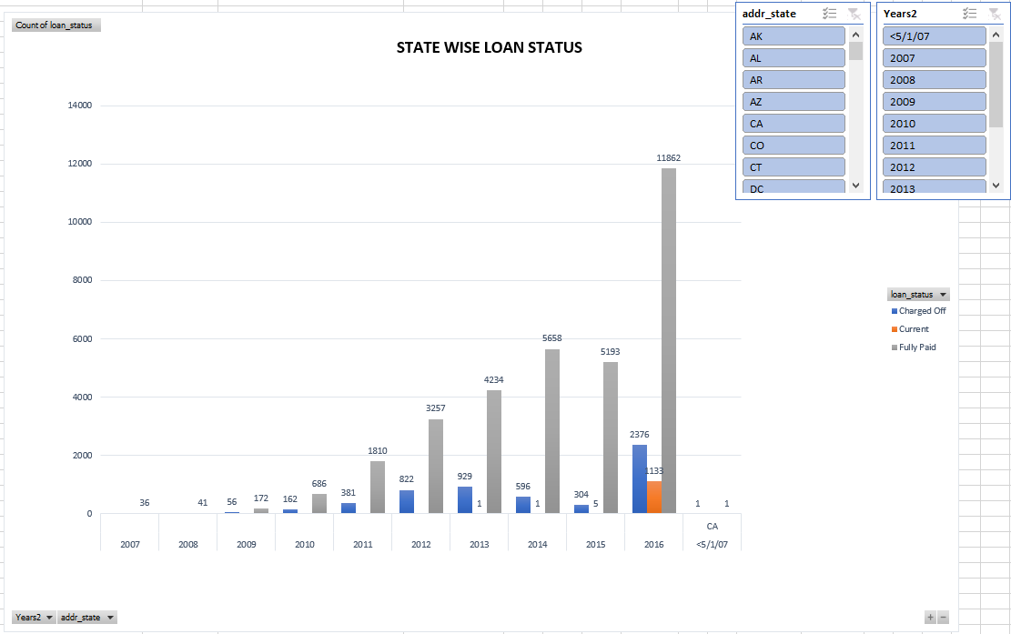
KPI-4 State wise and last credit pull d wise loan status.
If we see loan status, Majority of the states contains fully paid amount loan status. But if we see through the perspective of total payment, state NE has more total payment and state ID contains Less total payment amount.

Slide 9
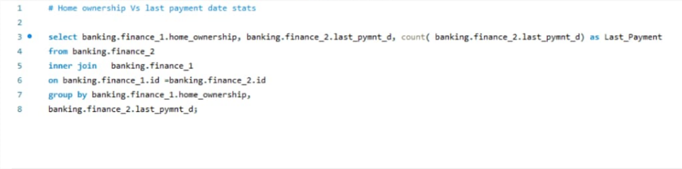
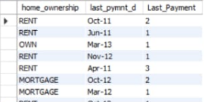
KPI-5 home ownership vs last payment date stats.
In the case of Home ownership, more people live on rent in 2012 and less in 2008. We have to pay more instalments on the Mortgage and others has to pay less instalments..

Slide 10
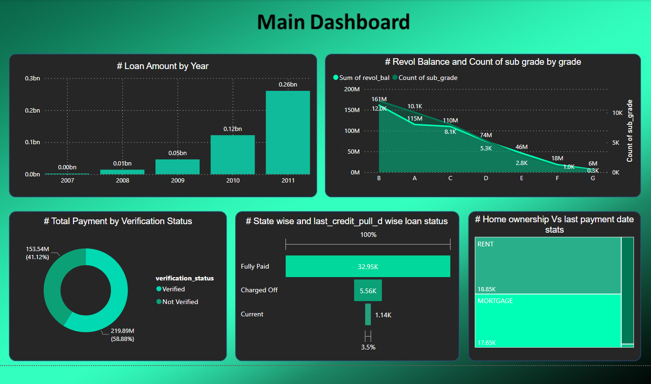
Main dashboard of finance analytics.

Slide 11
Challenges faced
We took on this duty and discovered that every year the loan amount was doubled compared to the previous year.
We have face the issue during importing an entire data in mysql.
Similar we have face the hurdle for importing years(dates) in tableau. So, we have converted string into date format

Slide 12
Summary:
We took on this duty and discovered that every year the loan amount was doubled compared to the previous year.
In my findings OK state has the least Loan occupancy, so focusing on increasing the number of clients will help the Business.
From given dataset, We are able to analyse that Loan amount is increasing year by year.
Most of the loan amount is taken for the purpose of debt consolidation which is most in year and less for purpose of renewable energy.
If we see in the case of education, reason behind the taking loan for education is student loan which is approx 84k and hence installment is also high

Slide 13
THANK YOU!

